Slide 1

Exploring Portfolio Decarbonization using AI
NUS Group 7
Ho Lok Sang Kelvin, Ho Jheng-Yuan, Soh Jun Heng, Lu Xinyi, Toh Hui Shan Alicia
Notes:
Good afternoon everyone. My team and I would like to present to you our project on exploring portfolio decarbonisation using AI and Machine Learning. My name is Kelvin and this is my team consisting of Nelson, Jun Heng, Alicia and our team lead Xinyi.

Slide 2

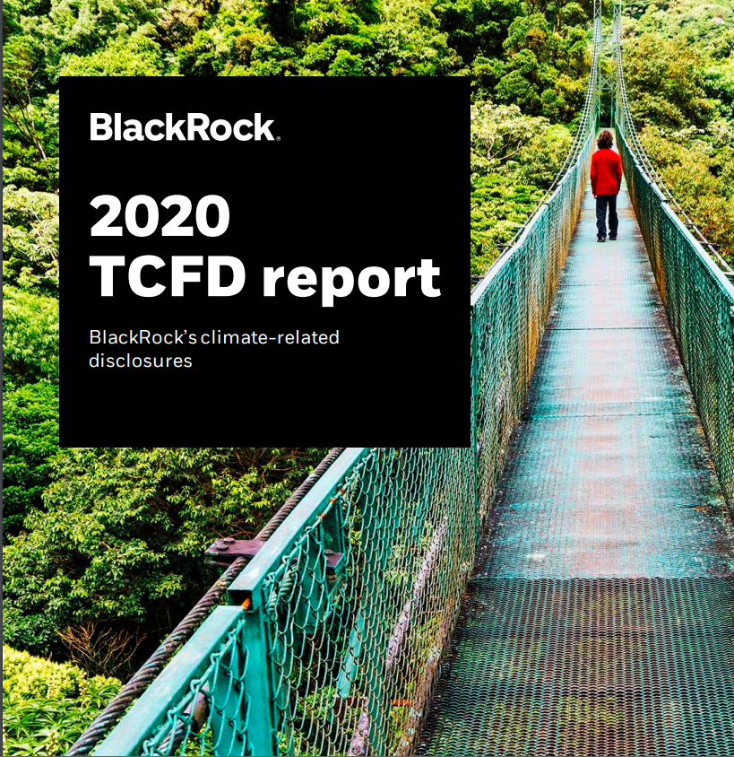



Rationale
Increasing importance of
ESG Investment
Participation in
global initiatives
Analysis of
Unstructured Data
Notes:
ESG in essence, refers to the investment of financial assets and decisions with respect to environmental, social and corporate governance factors. ESG assets will hit $53 trillion dollars in value by 2025, which reflects the rising importance in investing in ESG assets over the next few years. Corporate entities have also pledged themselves to various ESG initiatives and standards to reduce harmful impacts on various aspects on ESG. All these records are in form of PDF reports and unstructured texts which can be tedious to analyse and visualise.

Slide 3

Project Scope
Extract and understand information related to decarbonization
Capture decarbonization targets, efforts & approaches by financial institutions
Convert unstructured data into useful metrics to expedite decision making
Notes:
In our project scope, we aim to extract and understand information pertaining decarbonisation. We aim to consolidate the decarbonisation targets and approaches across different financial institution. Since most of the data that we will be dealing with is unstructured data, we would also aim to convert them into useful metrics to facilitate decision making

Slide 4
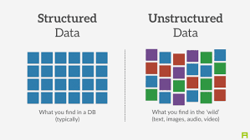

Current Business Problem
Availability of Information
Information Consolidation
Notes:
Lets talk about the current problem that many other companies like natwest markets are facing whilst collecting these data. Most of these data are in forms of text reports. It is humanly impossible to analyse large amounts of text data in a short amount of time. Therefore there is an increasing demand for natural language processing of these unstructured data to analyse latest trends and reports. This is crucial in making corporate and financial decisions

Slide 5
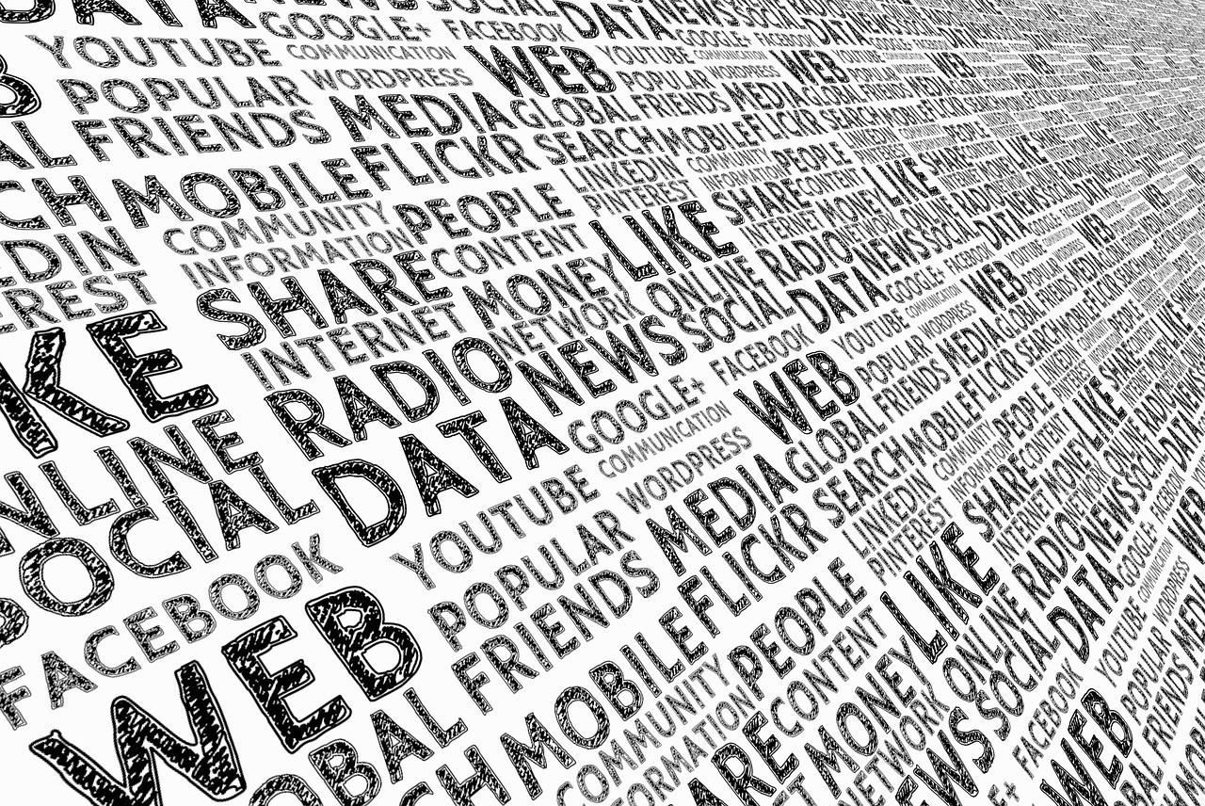
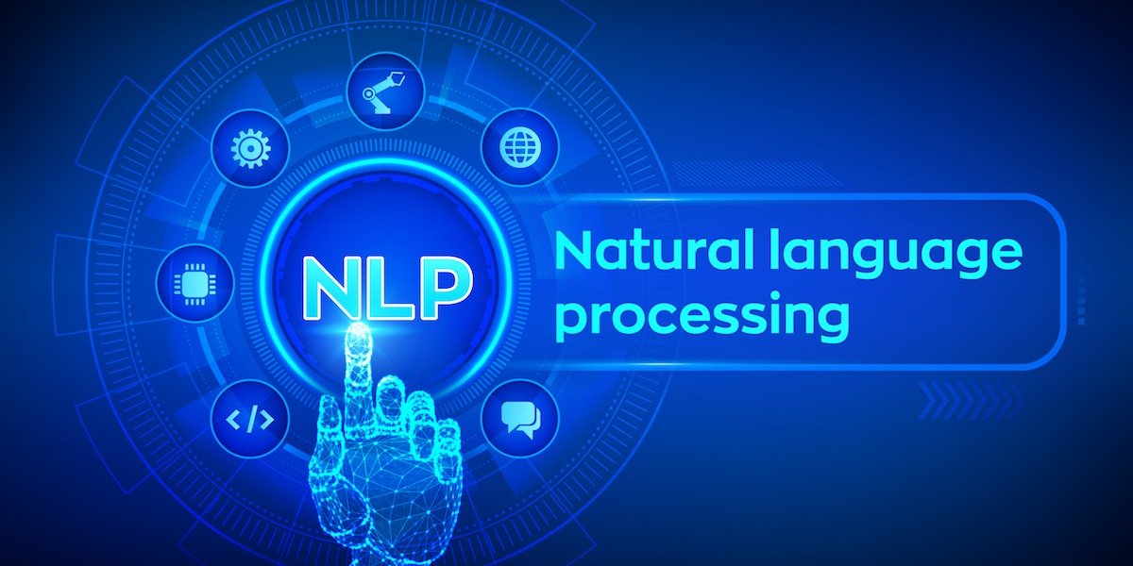
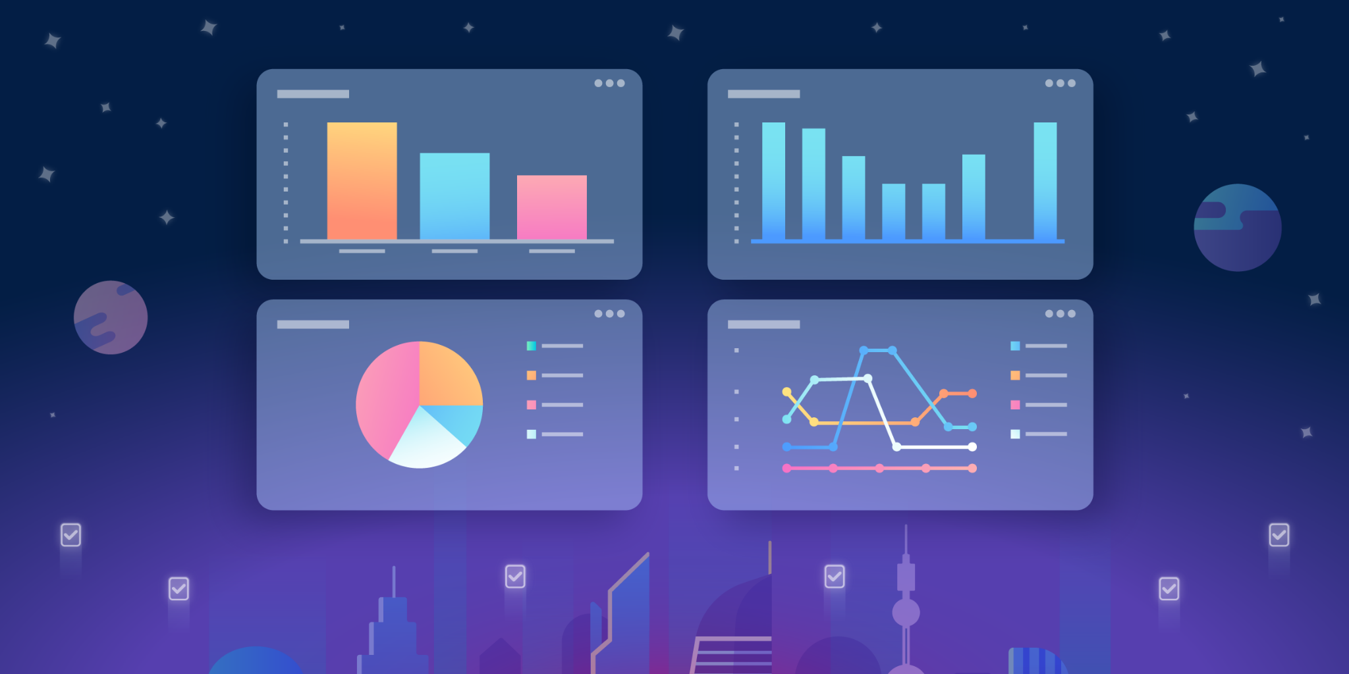
Project Outline
Informative and Consolidated dashboard
Data Extraction
Data Analysis
Scraping of text data from PDF files and conversion into text data tables
Optimized machine learning models to gauge sentiment based on frequency of words, topic modelling and classification
Help different companies monitor their progress towards reaching their decarbonization targets
Notes:
To give an outline of what we planned to achieve in this project, we first utilise python packages to extract the data we could from the pdf files and frame it with some form of structure. We then use different models to classify and perform sentiment analysis based on different keywords found in the data reports. We then summarise the data and the metrics we have performed on the documents in a dashboard where users are able to quantify how well the corporate institution performs in their decarbonisation effort

Slide 6
Data Collection
> 115
4
Companies
Types of Financial Institutions
Notes:
For our prototype, we have collected data from more than 115 companies from 4 types financial institutions. They are all from asian banks, pension funds, asset managers and insurance companies. We will now discuss in further detail how we prepare and preprocess these unstructured data.

Slide 7
Data Extraction
PyPDF2
textract
PyMuPDF
Illogical order of text
Not compatible with Windows
Optimal Results
Notes:
Thank you kelvin. For data extraction, we attempted several python packages, which are PyPDF2, pdfminer, and Textract.
For PyPDF2, we found that the extracted text are not ordered logically and the rate of illogical ordering increases as the documents get more complex
For textract, while it works slightly better than PyPDF2, the biggest issue was that it is not compatible with windows.
Finally, we opted for pymupdf as the text returned is in logical order and works well for all computers, hence it is overall the best solution for text extraction and we decided to stick to it.

Slide 8

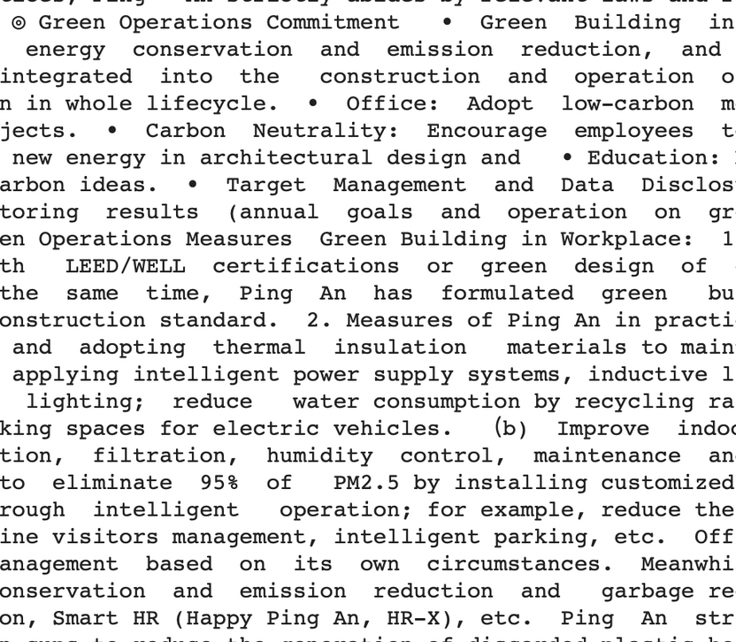
Data Extraction
Input: PDF downloaded manually from company's website
Process: Obtain text from a document using Textract package
Output: A .string that contains all the extracted information
PyMuPDF
Notes:
We have to download companies’ report from their website respectively for Textract to fetch data, as well as to process it using our machine learning models. After our code read in those reports, Textract can obtain text from those PDFs, and return a word file containing all the extracted information. This word file will then be pre-processed and ultimately, be used to build our model.

Slide 9
Data Pre-processing
Text cleaning: Drop special characters, non-English sentences, and lowercase text
Tokenization: Break the text into smaller chunks for machine learning models
Stopwords Removal: Remove words such as ‘in, ‘for’, to help our model read useful keywords only
Lemmatization: Brings words to their dictionary form with the goal of boosting text mining models
Notes:
After data extraction, we need to pre-process the data so that our machine learning models can process it.
The first step is to conduct text cleaning, which we will drop special characters like punctuation marks, non-English sentences, and lowercase all text.
The second step is to use tokenization, which breaks the text into smaller chunks so our machine learning models can analyse those.
Third step is to remove stop words such as ‘in’, ‘for’ to help our models read in useful keywords only.
Lastly, we lemmatize the text to bring words to their dictionary form to boost our text mining models.
I will now pass on the time to JunHeng on Data Analysis part

Slide 10
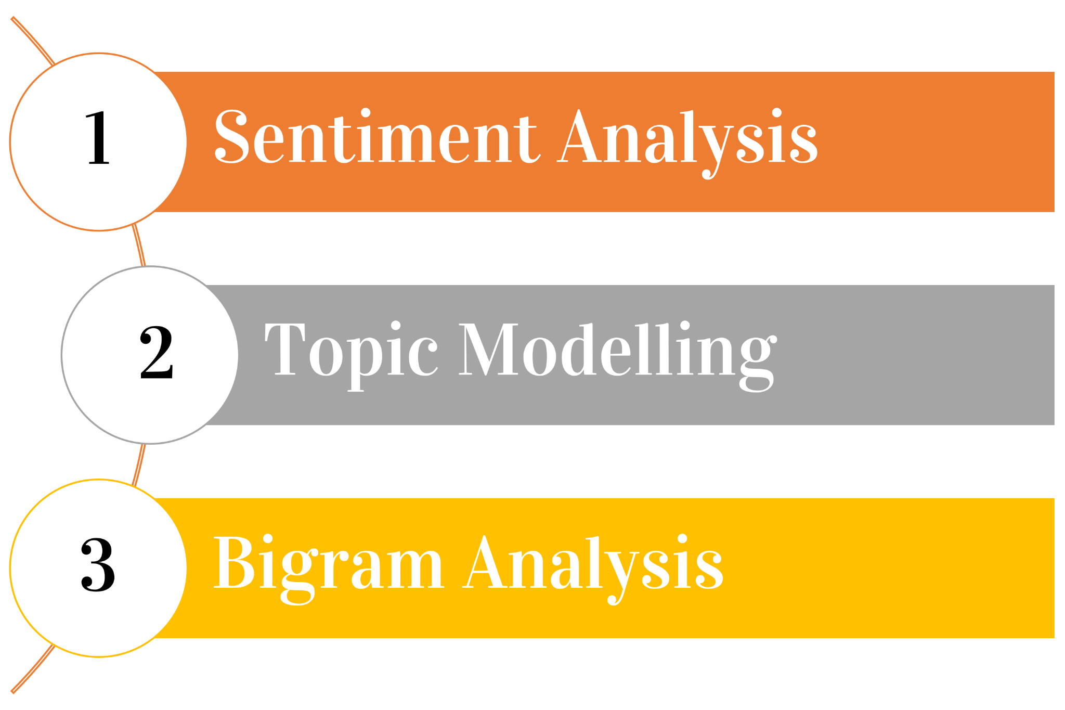


Data Analysis Approach
VS
Compare between
2 companies
Notes:
Thank you Nelson. Now I will be talking about data analysis. Our 3 main approaches towards data analysis, are sentiment analysis, topic modelling and bigram analysis. The ultimate goal is to make use of these 3 approaches to do a comparison between 2 companies on our dashboard.

Slide 11
Sentiment Analysis
Notes:
Our first approach will be sentiment analysis.

Slide 12
Calculation Of Sentiment Score
Text Polarity from TextBlob library
Total frequency of ESG related keywords and unique keywords
Sentiment (Comp)
= TextBlob Score + log [1 + (∑keywords ✕ ∑unique keywords)]
Notes:
Using the data frame for each of the 4 different types of financial institutions, we computed the sentiment score for each of the sentences for each company. The sentiment score is calculated using 2 different components. The first component consists of using the TextBlob library available in python which gives us a general overall sentiment level of each sentence, with a score ranging from -1 to 1. However, this alone does not give an accurate gauge of the company’s level of optimism towards decarbonisation. Thus, we wrote a function to calculate the frequency of ESG and decarbonisation related keywords for each of the sentences. Some examples of these keywords include “clean technology”, “sustainable technology” and “green bonds”. Finally, the overall final sentiment level is calculated using the formula illustrated below. Based on the formula shown below, if a company has a higher number of esg keywords and unique keywords, the sentiment score computed will be higher.

Slide 13



Sentiment Analysis
Company’s sentiments towards portfolio decarbonization
19%
68%
13%
Notes:
With the sentiment score generated, We can move on to conduct sentiment analysis. The main purpose of our sentiment analysis is to gather results on each company’s overall sentiments towards portfolio decarbonization, whether they are favourable towards it or against it. Based on our analysis, 19% of the companies are deemed to be optimistic towards decarbonisation, 68% have a neutral stance towards decarbonisation whereas the remaining 13% of the companies are pessimistic.

Slide 14
Comparison of ML models
Model | Accuracy | Recall | F1
Decision Tree Classifier | 0.848 | 0.810 | 0.823
Logistic Regression Classifier | 0.862 | 0.735 | 0.820
Adaboost | 0.723 | 0.220 | 0.363
Naive Bayes Classifier | 0.723 | 0.748 | 0.675
Notes:
The following table shows the accuracy score, recall and F1 for the various machine learning models we used to predict the sentiment labels of unseen sentences. The metrics are computed based on the average of the 4 financial institutions. We could see that Decision Tree fared the best for both recall and f1 score, whereas logistic regression achieved a higher accuracy score.

Slide 15
Topic Modelling
Notes:
The next text analysis technique that we implemented is topic modelling.

Slide 16
Topic Modelling
To discover a set of topics and words from the collection of company reports
Latent Dirichlet Allocation Mallet (LDAMallet) algorithm from the Gensim package
Find mixture of words associated with each topic
To summarise complex reports into specific themes (decarbonization related vs decarbonization unrelated)
To infer the distribution of decarbonization related topics in a report
Notes:
It is a useful technique that helped us in discovering a set of topics and words from our collection of company reports. Specifically, the Latent Dirichlet Allocation Mallet algorithm( or LDAMallet for short) from the Gensim package was used in our implementation. LDA is a method to find the mixture of words associated with each topic. Words are aggregated depending on the K topics that capture the hidden variables.
The goal of topic modelling is to summarise complex reports into specific themes such as decarbonization related vs decarbonization unrelated. This is helpful for us to infer the distribution of decarbonization related topics in each company’s report.

Slide 17
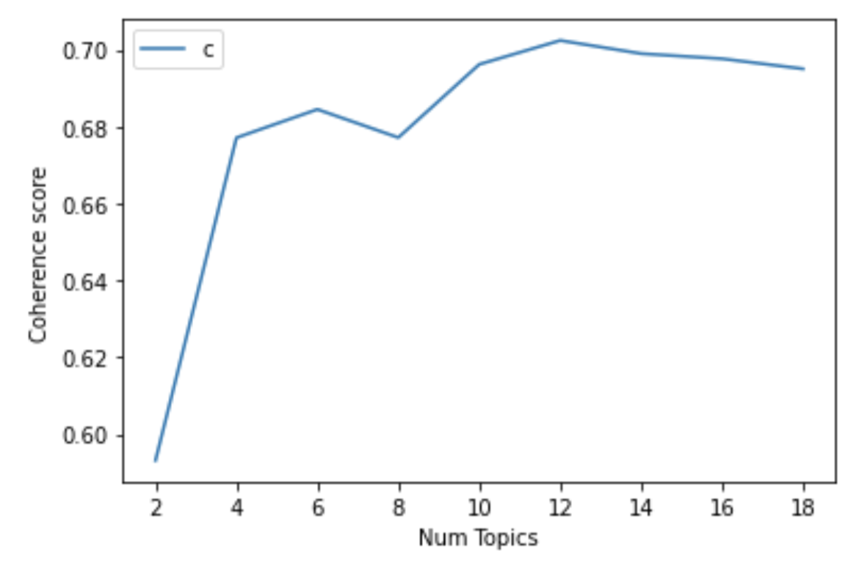
Topic Modelling
Quality of model depends on optimal number of topics
Higher coherence score gives a better LDA model
Chosen Model: 12 topics with coherence score of 0.7024
Notes:
The challenge of topic modelling is to extract a good quality of topics that are clear and meaningful and this depends heavily on the optimal number of topics. To assess the quality of the learned topics and to understand how our model is performing, we make use of the coherence score. Coherence score scores a single topic by measuring the degree of semantic similarity between high scoring words in the topic. A higher coherence score implies a better model. Therefore, our approach is to build many LDA models with different values of the number of topics and pick the one that gives the highest coherence value. The optimal number of topics will change accordingly depending on the input data. For our current dataset, we chose the model with 12 topics as it attained the highest coherence score of 0.7024.

Slide 18
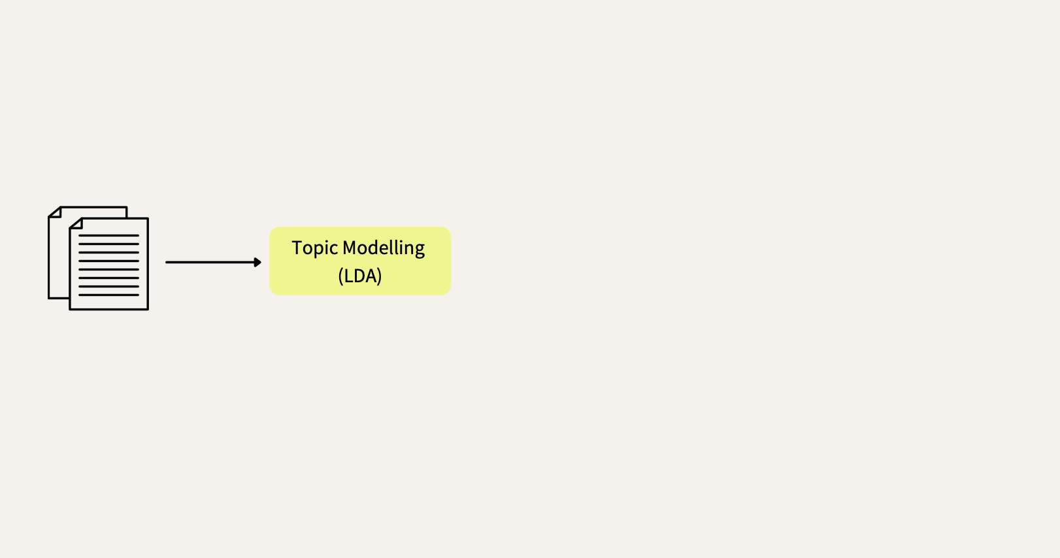
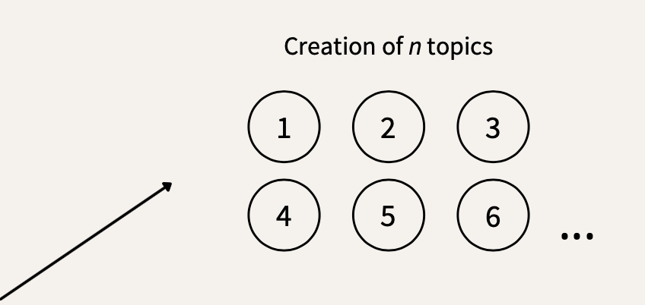
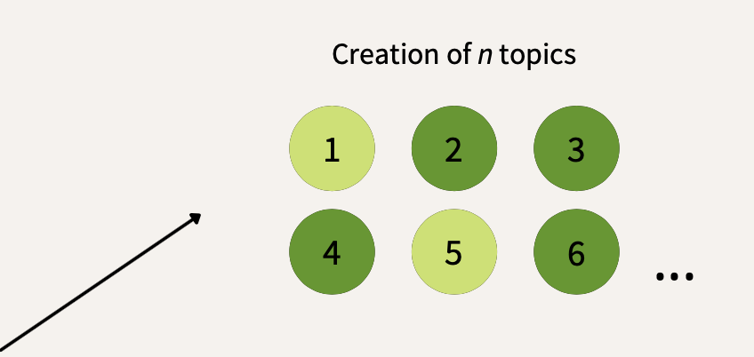
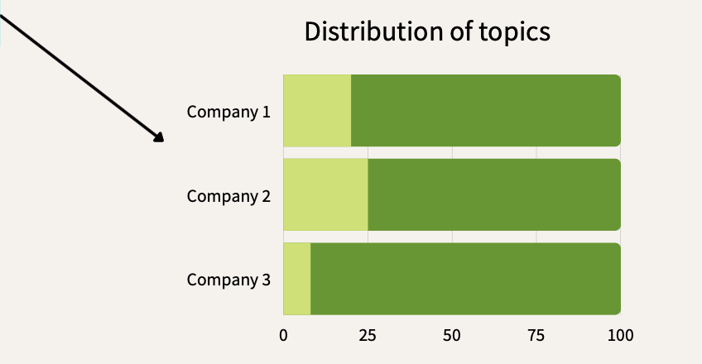
Topic Modelling
Notes:
After building the optimal LDA model, (*) our algorithm will determine whether a topic is decarbonization related or not depending on the keywords that make up each topic. For instance, topic that consists of keywords such as climate, green and carbon will be considered as topic related to decarbonization. (*) Finally, we were able to calculate the distribution of decarbonization related sentences for each company

Slide 19
Bigram Analysis
Notes:
Using the optimal LDA model, we were able to extract sentences related to portfolio decarbonization and we proceeded to conduct bigram analysis on them.

Slide 20
Bigram Analysis
TfidfVectorizer Library
Useful since a very large text dataset is used
Bigrams capture structure that is overlooked when analysing single words
Bigrams provide context
Single Word | Bigram
Green | Green bond
Finance | Sustainable Finance
Notes:
The TfidfVectorizer library was used for this analysis. Bigrams are especially useful since a very large text dataset is used. Furthermore, pairs of consecutive words might capture structure that is not present when one is just counting single words, and may provide context that makes words more understandable. For example, “green bond” is more informative than “green” and similarly, “sustainable finance” is more explanatory than “finance”. We observe that bigrams can effectively reflect the key decarbonization topics that are discussed by a company and informs users of its decarbonization approach and targets. This increases the relevance of the information intended to be shown on the dashboard.

Slide 21
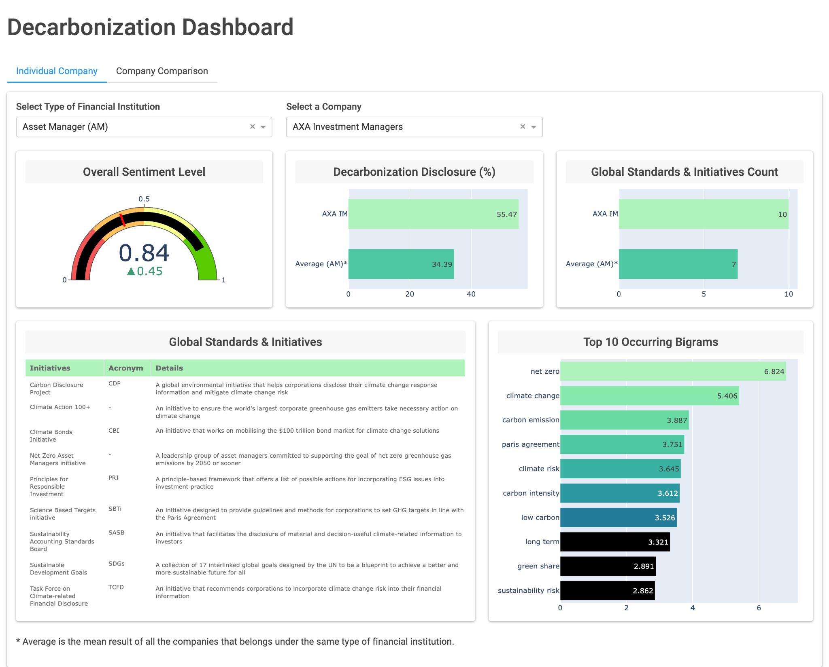
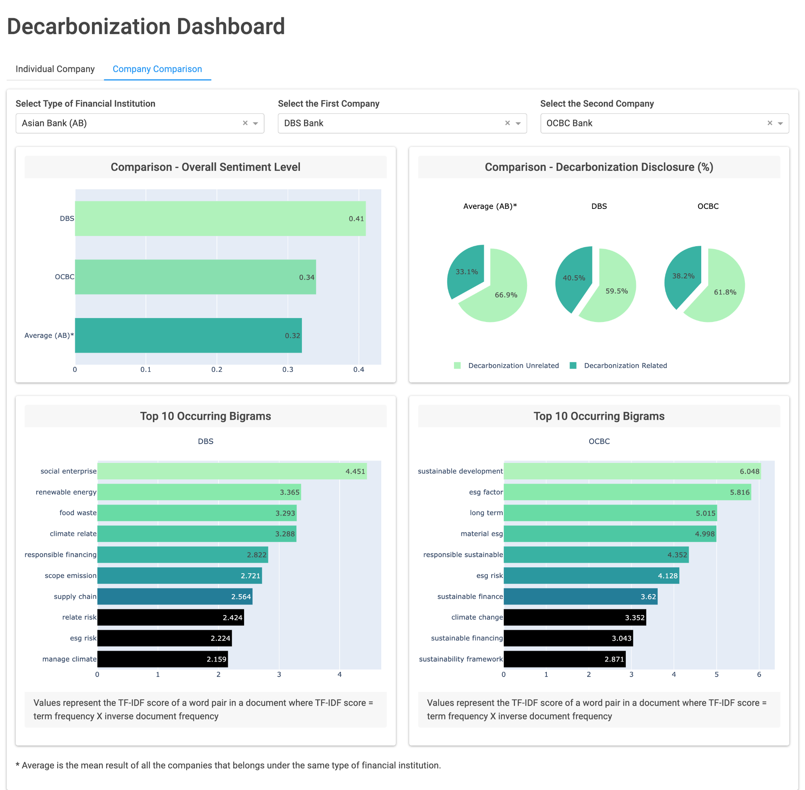
Dashboard Overview
Notes:
Thank you Jun Heng. So, at this point, we have already tackled various processes which includes transforming the unstructured data into structured form and using machine learning algorithms to conduct data analysis. The last step would be to represent the data on a dashboard such that stakeholders at NatWest Markets will be able to derive actionable insights and make better investment decisions.

Slide 22
Dashboard Objectives
Relevant & Informative
Diverse Data Visualization
User Friendly & Interactive
Notes:
Here are 3 objectives we hope to achieve using our dashboard. Using diverse data visualization charts, we want to present relevant & informative metrics in a way to help our stakeholders in making decisions. To ensure that our dashboard is user friendly and interactive, we included dropdown tabs, chart zoom and tooltip features. We will now be conducting a demo to show how our dashboard functions and how we have chosen to display these data in the best way.

Slide 23
Future Works
Dashboard
Increase the number of filter options
01
02
03
Runtime
Dashboard
Expedite LDA training process
Drill down on bigram analysis
Notes:
Moving on, we believe that future enhancements can be made to bring further benefits to Natwest Markets. Firstly, the current time required to train our LDA model can be quite long and may be a hindrance for users seeking a time-efficient implementation. Some options that may have the potential of speeding up the current process includes exploring with trigrams or different lemmatization options. Next, to make our dashboard even more user-friendly, we propose including more interactive elements such as increasing the number of filter options and introducing drill downs on our bigram plot.
Time constraints, GPU constraints we were not able to do it
Summary of your learning (key takeaways)

Slide 24
Takeaways
Understanding business issue
01
02
Natural Language Processing
03
04
Teamwork
Project Management
Notes:
Overall, this has been an invaluable learning experience for us. Firstly, we have better understood the issues and problems faced by financial institutions, especially in the face of a low carbon future. Next, this project provided us with a platform to hone new skills in NLP and lastly, for the opportunity to work as a team to overcome challenges and achieve project goals.

Slide 25
Conclusion
Notes:
Moving forward, we would like to reassure NatWest Markets that this is not a one off project. Our algorithm has the capability to take in a whole new set of data, run the machine learning algorithms once again and display an updated but still accurate dashboard. The detailed procedure has been documented in the user guide which will be included during the hand over. Overall, our group is very thankful to have this opportunity to work with Natwest Markets and we truly appreciate the guidance from Prof Lee and Mr Puneet. We hope that our project will be beneficial to the company in the long run.

Slide 26
Thank You
Notes:
With that, we have come to the end of the presentation. Thank you and we are open to any questions.

Slide 27
Q&A
Notes:
Open to Q&A

Slide 28
References
Photos:
https://www.southpole.com/uploads/thumbs/green-investment-1_800w.png
https://www.ing.com/upload_mm/d/0/d/b0eecce6-dbf4-4559-821a-56b5be093ed2_CDP-680x300_500x220.jpg
https://www.gcca.eu/themes/custom/porto_gcca/assets/dist/images/logo/logo_footer_en.png
https://asics-corporate-production-draft.s3.amazonaws.com/qor_media_library/qor/widget/view_setting/6400/190924-1.5%E5%BA%A6%E7%9B%AE%E6%A8%99%E3%81%A8CO2%E6%8E%92%E5%87%BA%E3%82%BC%E3%83%AD%E3%81%B8%E3%81%AE%E3%82%B3%E3%83%9F%E3%83%83%E3%83%88%E3%83%A1%E3%83%B3%E3%83%88%E8%A1%A8%E6%98%8E2_original.jpg?1569289651
https://resources.m-files.com/blog/what-is-structured-data-vs-unstructured-data-3
https://thumbor.forbes.com/thumbor/960x0/https%3A%2F%2Fspecials-images.forbesimg.com%2Fimageserve%2F5f5afcbb8de14d399113ebc7%2F4-Simple-Ways-Businesses-Can-Use-Natural-Language-Processing%2F960x0.jpg%3Ffit%3Dscale
https://blog.trello.com/hubfs/DashboardFinal.png
https://s24.q4cdn.com/856567660/files/design/logo-black.png
https://upload.wikimedia.org/wikipedia/commons/thumb/3/31/Credit_Suisse_Logo.svg/2560px-Credit_Suisse_Logo.svg.png

Slide 29
Appendices
Example of cleaned text:

Slide 30
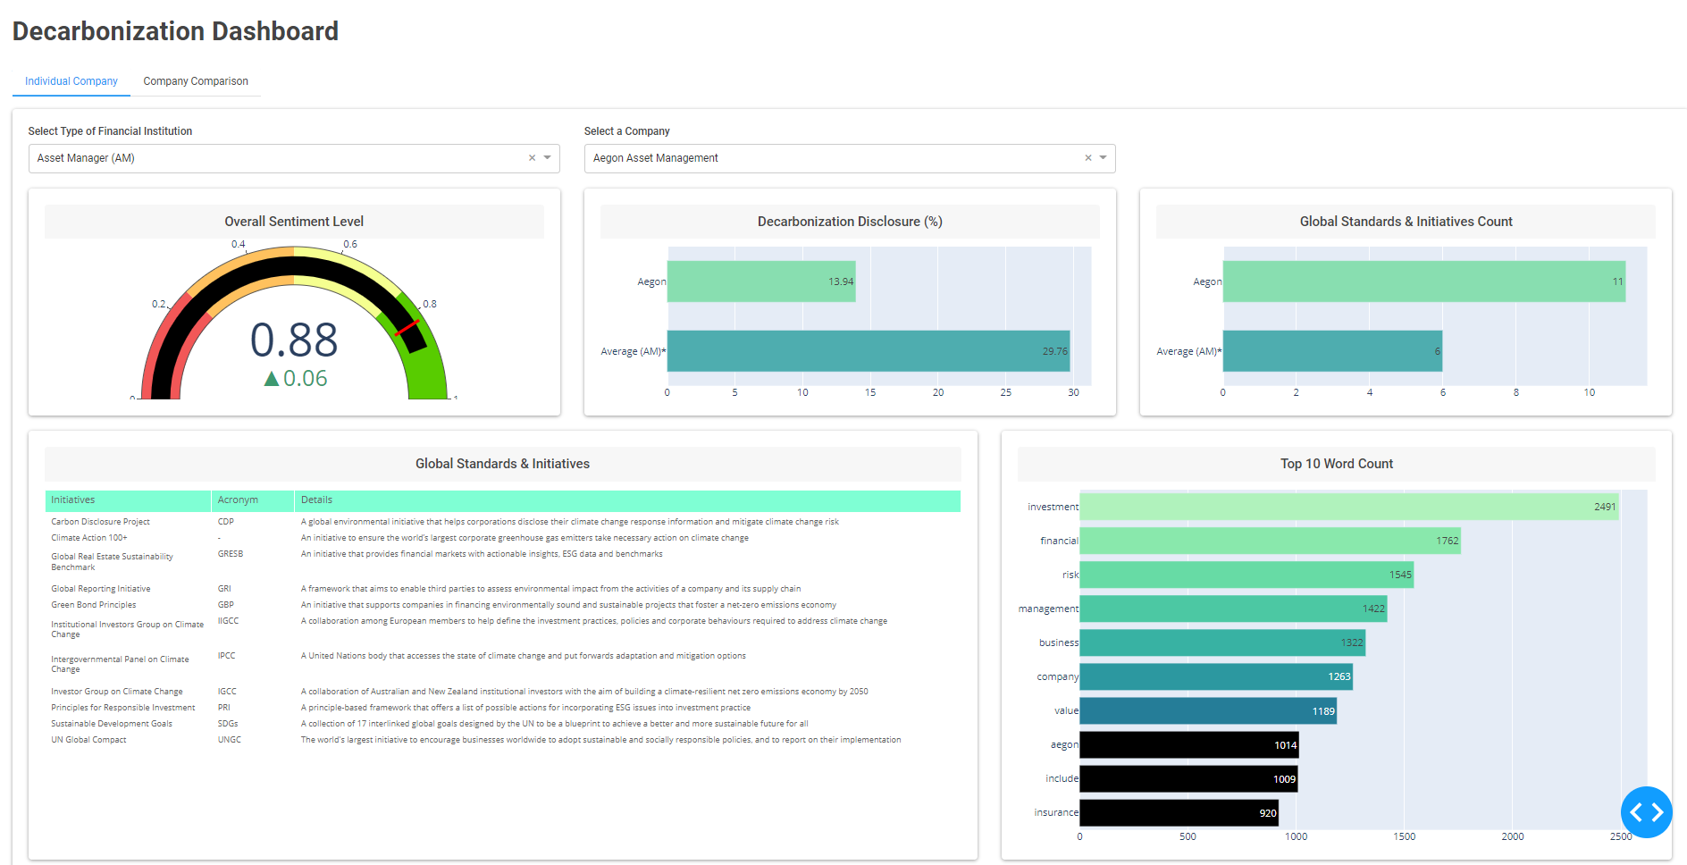
Appendices: Dashboard (Landing Page)
Notes:
Thank you Jun Heng. So, at this point, we have already tackled various processes which includes transforming the unstructured data into structured form and using machine learning algorithms to conduct data analysis. The last step would be to represent the data on a dashboard such that stakeholders at NatWest Markets will be able to derive actionable insights and make better investment decisions. We will now be conducting a demo to show how our dashboard functions and how we have chosen to display these data in the best way.
We will be moving on to explain how we have chosen to display these data in the best way, making it easy to analyze and actionable for our intended users.
With data from

Slide 31
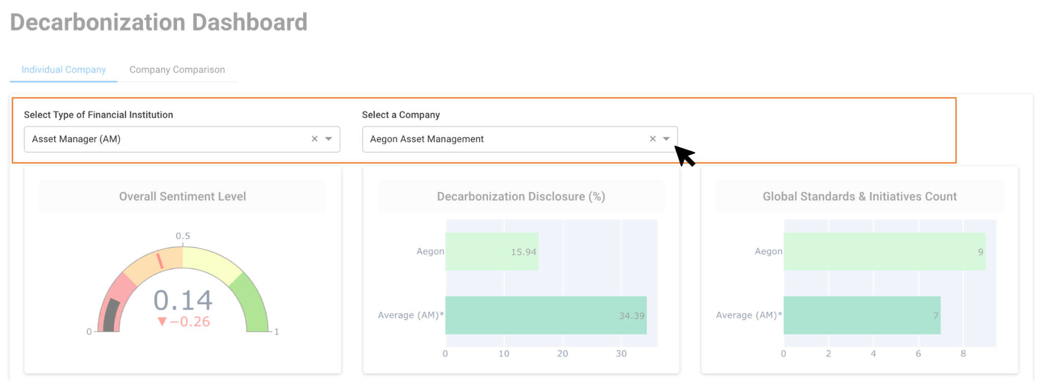
Appendices: Dashboard (First Interface)
4 Types of Financial Institutions:
Asian Bank
Asset Manager
Insurance Company
Pension Fund
Notes:
First, there are 2 dropdown filters on the first interface. (*) Users will first select the type of financial institution from asian banks, asset managers, insurance and pension funds. Then they may proceed to select a particular company that they are interested in. Users have 2 methods of achieving this. They can either scroll through the dropdown menu or directly type their search option into the box.

Slide 32
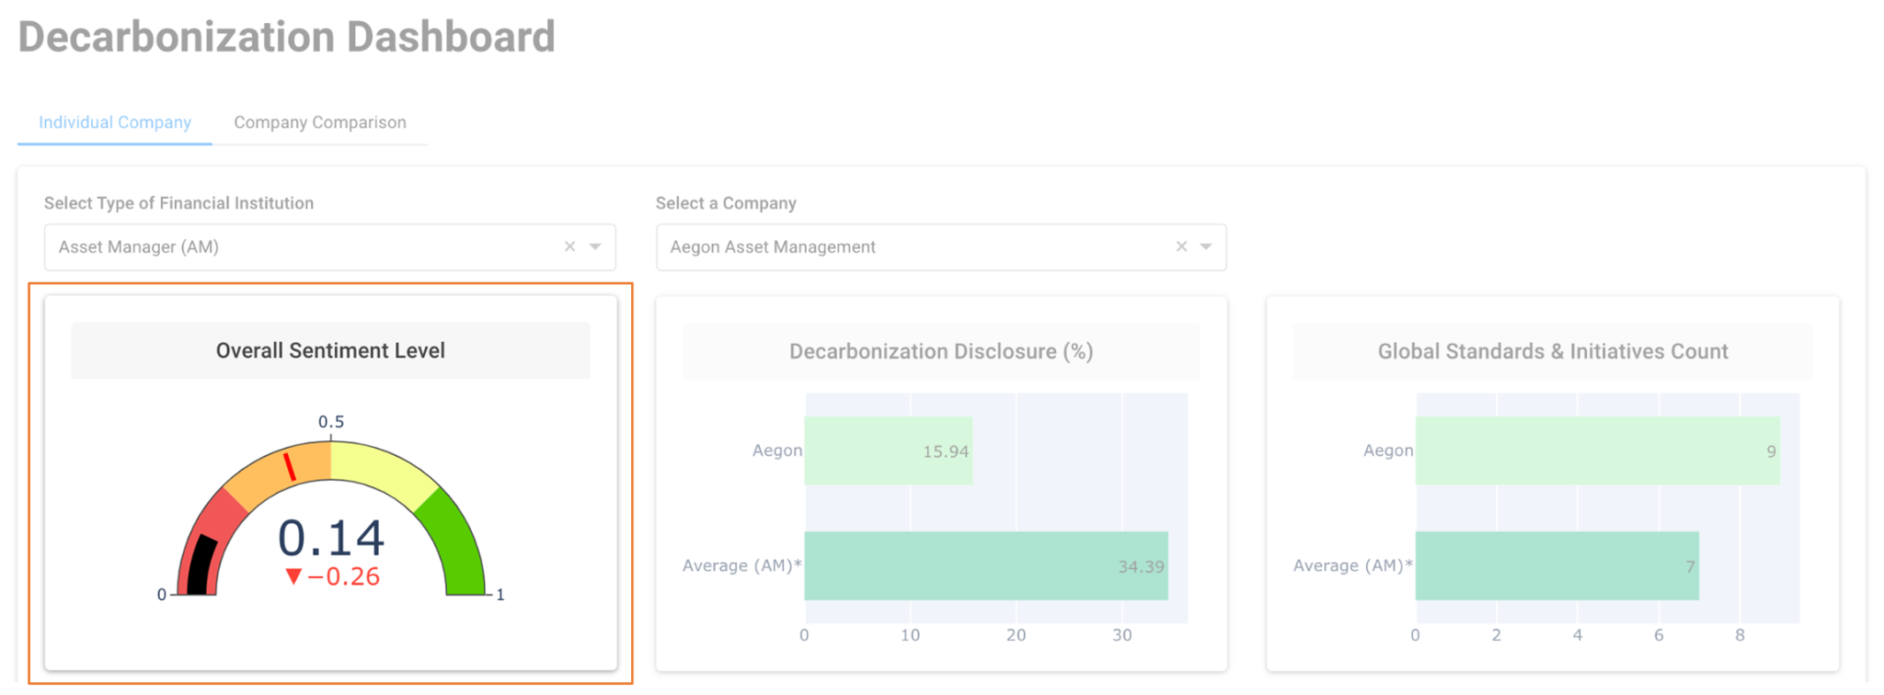
Appendices: Dashboard (First Interface)
Overall Sentiment Level
Overall picture of a company’s decarbonization progress
Summarizes a company’s attitude and commitment
0 (less desirable) to 1 (desirable)
Notes:
Once a company is selected, the metrics below will be refreshed instantly. To start off, we have a gauge chart displaying the overall sentiment level of a company. (*) The goal is to first provide users will an overall picture of how well a company is progressing towards portfolio decarbonization. It is a good summarization of a company’s attitude and level of commitment towards decarbonization. The sentiment level ranges from 0 to 1, with 0 representing pessimism towards portfolio decarbonization & 1 representing optimism towards it. The black bar and top number represents the company’s score while the red line and bottom number is the comparison with the average. Taking Aegon as a reference, it has a sentiment level of 0.14 which is 0.26 lower than the average of all companies that are Asset Managers.

Slide 33
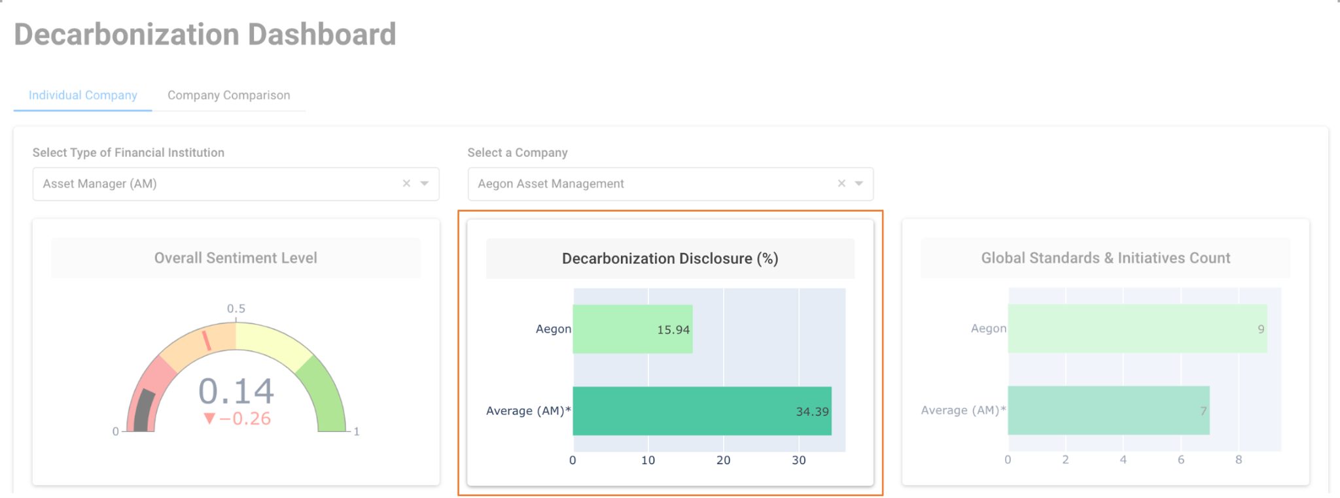
Appendices: Dashboard (First Interface)
Percentage of Decarbonization Disclosure
How much a company discusses about their decarbonization effort
Reflects a company’s level of transparency
Notes:
To further explore the decarbonization performance of a company, we have the next bar chart which compares the company’s decarbonization disclosure with the average of all companies from the same type of financial institution. (*) This score is a measure of how much as company discusses about their decarbonization effort in their reports. A higher score indicates that the company is more transparent about releasing information regarding reduction of carbon footprints. Thus, users may infer that these companies are more actively working towards achieving their decarbonization goals and aligning low-carbon operations with their overall business strategies. As part of their decarbonization disclosure, companies also informs stakeholders about the global initiatives that they are actively participating in. Therefore, the next two visualizations will provide us with deeper insight on it.

Slide 34
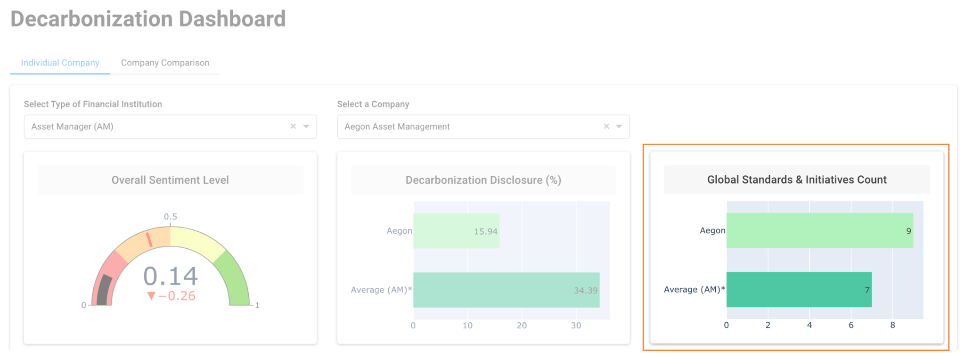
Appendices: Dashboard (First Interface)
Number of Global Standards & Initiatives
Examples: Carbon Disclosure Project, UN Global Compact
Reflects level of support towards the adoption of industry standards
Effort in incorporating ESG criteria into decision making
Notes:
The next bar chart displays the number of global standards and initiatives that a company is committed to. (*) Our algorithm extracts the relevant initiatives from each report and total them up for each company. Some examples of initiatives and standards are Carbon Disclosure Project and UN Global Compact. This metric shows the company’s level of support towards the adoption of industry standards and guidelines. A higher number thus implies that a company is making a more conscious effort to consider ESG criteria in their decision making processes.

Slide 35
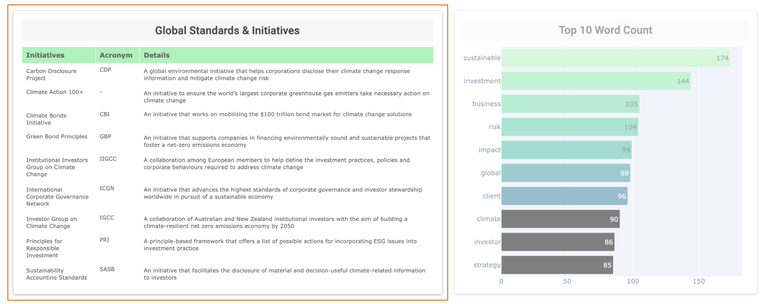
Appendices: Dashboard (First Interface)
Table of Standards & Initiatives
List of initiatives & standards
Short description included
Notes:
The next chart is a continuation from the previous metric. (*) It is a table that helps users dive deeper into the specific initiatives and standards that a company is committed to. The table also comes with the acronym of the initiative and a short description. Users who are interested to find out if a company have signed up for a particular initiative or standard eg. TCFD, may look out for it under this table.

Slide 36
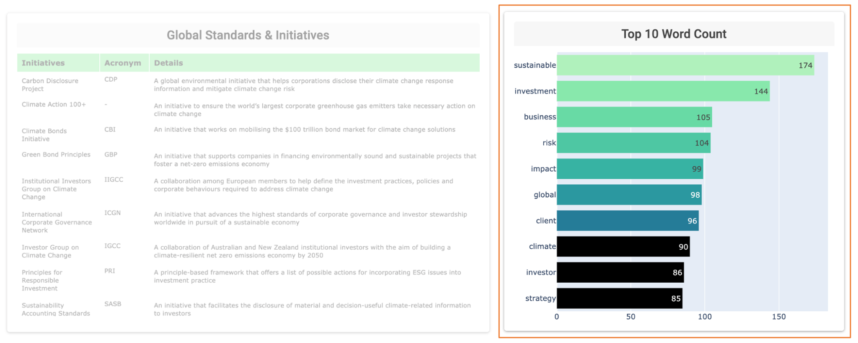
Appendices: Dashboard (First Interface)
Top 10 Word Count
Represents the commonly discussed topics
Emphasis on portfolio decarbonization
Notes:
Last of all, we have put together the top 10 words that occur in a company’s reports. (*) The count of each word is displayed on the bar chart too. These words highlight the commonly discussed topics by a company. For example, if the majority of the top ten words are related to decarbonization, the company is likely to be putting a greater focus on integrating decarbonization considerations into their portfolios and daily practices.

Slide 37
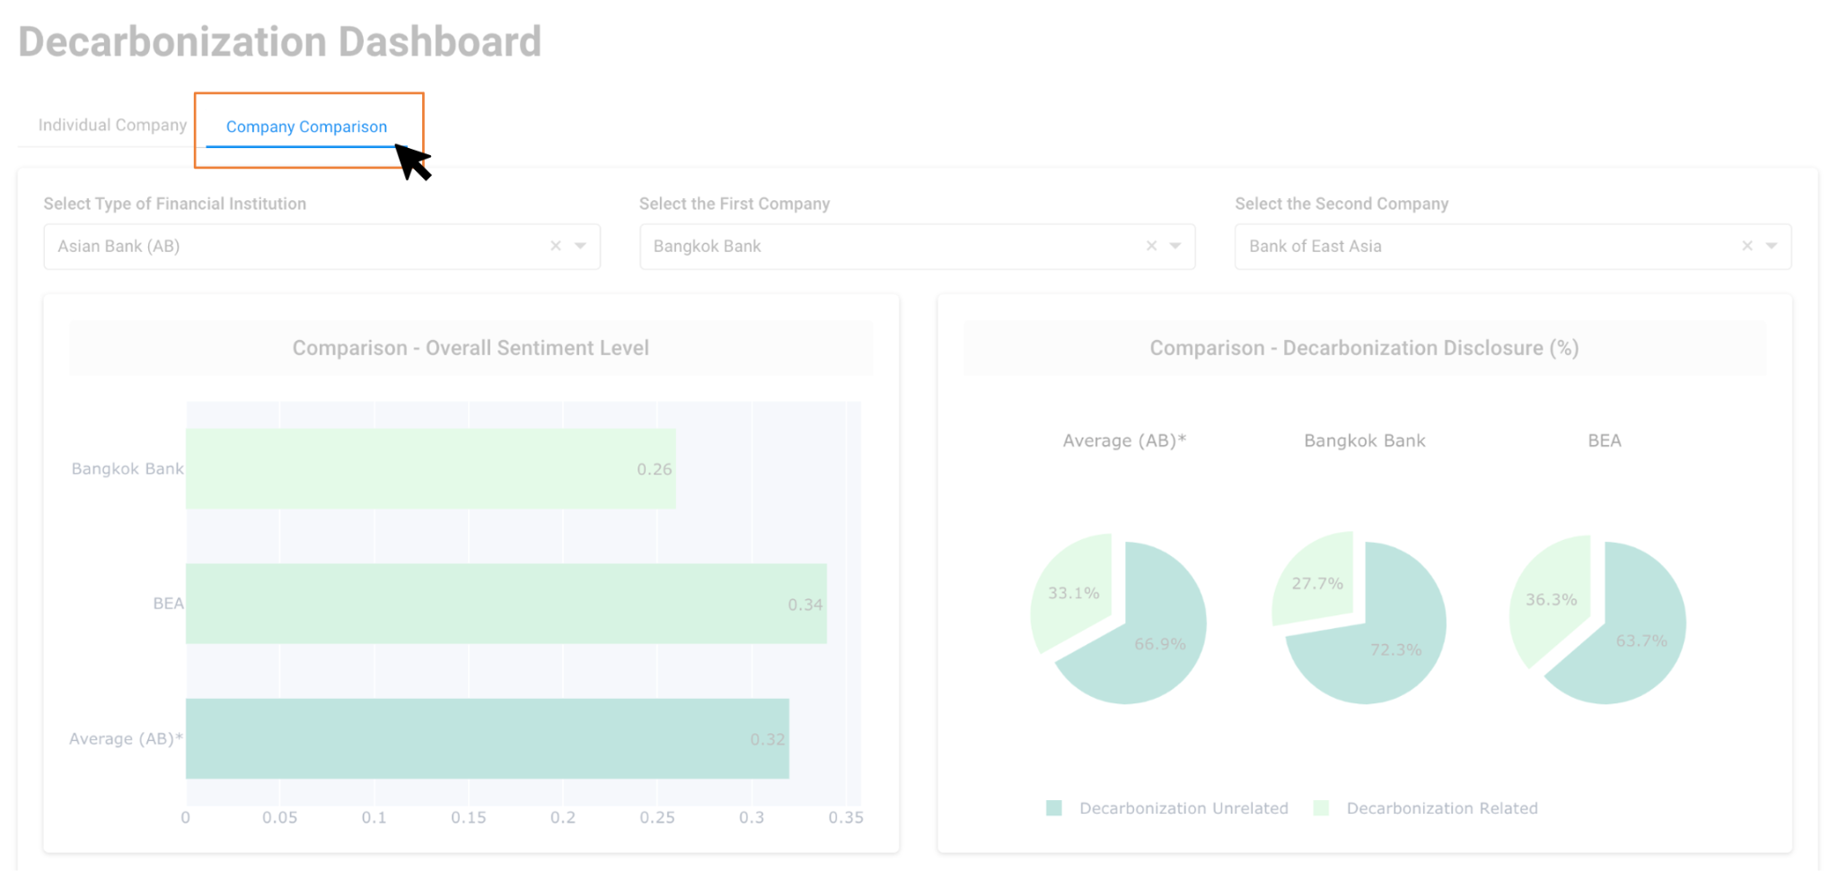
Appendices: Dashboard (Second Interface)
Notes:
Comparing the decarbonization efforts of companies can be tedious and time consuming. When making business decisions, users are likely to have multiple internet browser tabs open to compare the companies they are interested in. To address this issue, we introduce our Company Comparison interface. It is an easy-to-use feature that enables users to compare companies faster and more efficiently.

Slide 38
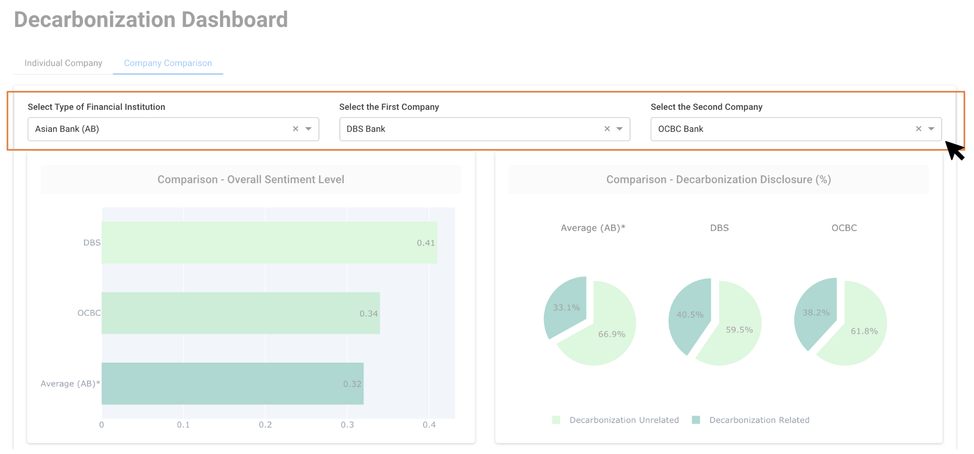
Appendices: Dashboard (Second Interface)
Notes:
Users can simply compare companies across the different key performance indicators by first selecting a type of financial institution, followed by choosing any two companies to compare. For the subsequent slides, I will be taking the example of comparing between 2 Singapore banks, namely DBS bank and OCBC bank.

Slide 39
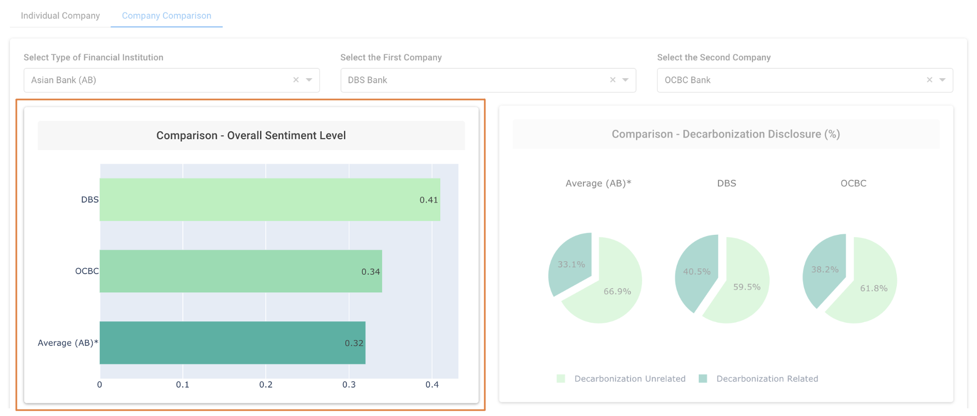
Appendices: Dashboard (Second Interface)
Overall Sentiment Level
Comparison between companies & against average
Rough impression of a company’s decarbonization efforts
Calculated based on:
Tone
Frequency of decarbonization related information
Notes:
Moving on to the first visualization. (*) Our dashboard first starts off by comparing the overall sentiment level of each company, as well as its performance against the average. The goal is to first provide users with a rough impression of how each company is likely to fare against each other in terms of their decarbonization efforts. From the diagram, we observe that both DBS and OCBC are performing better than average, with DBS having a higher score than OCBC. This score is calculated based on two criteria, first based on the tone of how the report is written and second, based on the frequency of decarbonization related information in a report.

Slide 40
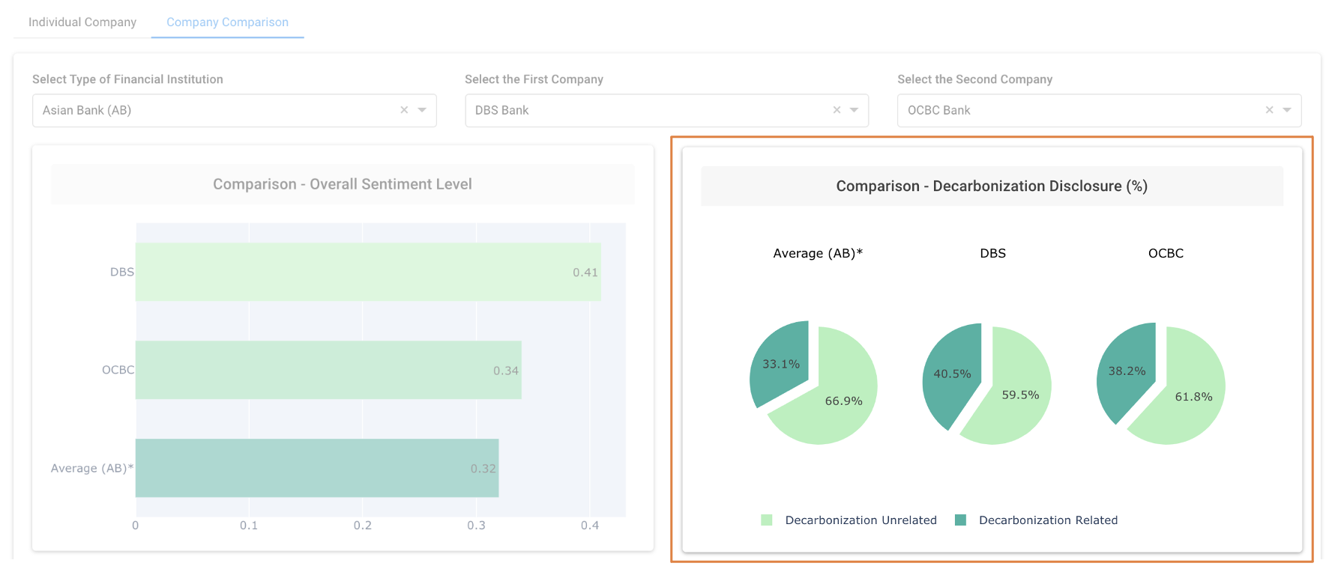
Appendices: Dashboard (Second Interface)
Decarbonization Disclosure (%)
Breakdown of information in a report
Compare level of disclosure & transparency between companies
Useful metric for decision making
Notes:
To dive deeper into the latter (*), our second visualization provides a breakdown of the information in a report into decarbonization related and decarbonization unrelated. These pie charts are designed to compare the level of disclosure between companies and the level of transparency they each exercise. As we transition into a low carbon economy, more and more investors are perceiving decarbonization disclosure as crucial in helping them make better assessment of a firm’s future business scenario, therefore we believe that this would be an useful metric for users.

Slide 41
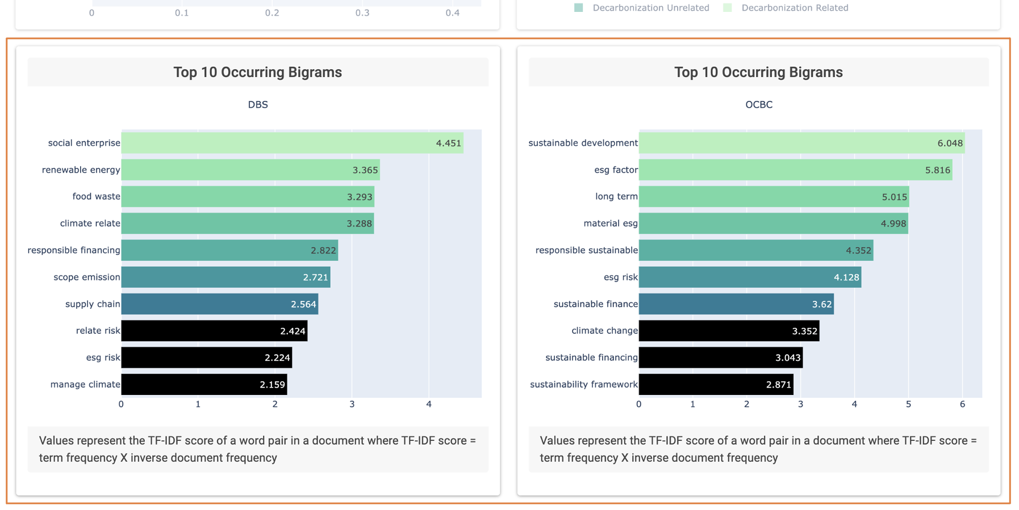
Appendices: Dashboard (Second Interface)
Bigram Analysis
Top 10 occurring word pairs mentioned by each company
Explains how a company is making progress towards decarbonization
Approach to align portfolio with a low carbon future
Notes:
Naturally, the next question that comes to mind would be what are some of the decarbonization related information discussed by each company. Therefore we conducted deeper analysis of these information and plotted them the next two diagrams. (*) These diagrams provides a more detailed overview of the top 10 occurring word pairs mentioned by each company. This enables users to better understand how a company is making progress and aligning their portfolio with a low carbon future. Looking at the bigrams of DBS, we can pick up that renewable energy and responsible financing are some key decarbonization themes that it is working towards.

